Slide 1

Control Statements

Slide 2
Decision Making statements

Slide 3
Java if Statement
if statement is used to test the condition.
Checks boolean condition: true or false.
There are various types of if statement in Java.
if statement
if-else statement
if-else-if ladder
nested if statement

Slide 4
Java if Statement
if statement tests the condition.
It executes the if block if condition is true.
Syntax:
if(condition)
{
//code to be executed
}

Slide 5
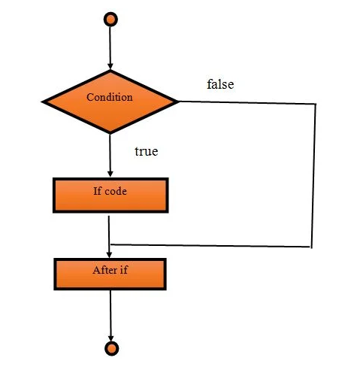
Data-flow-diagram of if Block

Slide 6
Example
public class IfDemo1 {
public static void main(String[] args)
{
int marks=70;
if(marks > 65)
{
System.out.print("First division");
}
}
}

Slide 7
Java if-else Statement
It executes the if block if condition is true otherwise else block is executed.
Synatax:
if(condition)
{
//code if condition is true
}
else
{
//code if condition is false
}

Slide 8
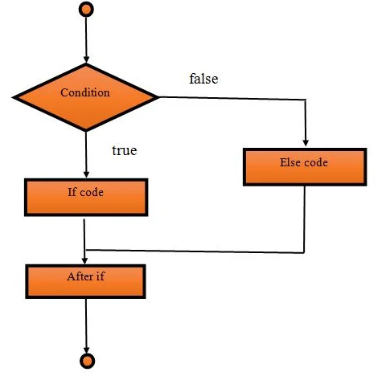
Data-flow-diagram of if else Block

Slide 9
Example
public class IfElseDemo1 {
public static void main(String[] args)
{
int marks=50;
if(marks > 65)
{
System.out.print("First division");
}
else
{
System.out.print("Second division");
}
}
}

Slide 10
Java if-else-if ladder Statement
The if-else-if ladder statement executes one condition from multiple statements.

Slide 11
if(condition1)
{
//code to be executed if condition1 is true
}
else if(condition2)
{
//code to be executed if condition2 is true
}
else if(condition3){
//code to be executed if condition3 is true
}
...
else{
//code to be executed if all the conditions are false
}

Slide 12
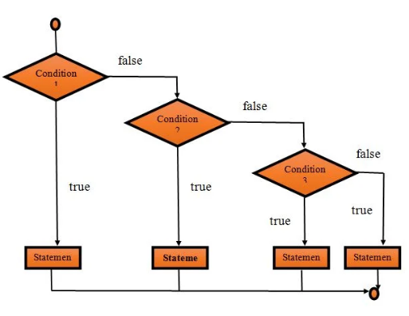
Data-flow-diagram of If Else If Block

Slide 13
int marks=75;
if(marks<50)
{
System.out.println("fail");
}
else if(marks>=50 && marks<60)
{
System.out.println("D grade");
}
else if(marks>=60 && marks<70)
{
System.out.println("C grade");
}
else if(marks>=70 && marks<80){
System.out.println("B grade");
}
else if(marks>=80 && marks<90)
{
System.out.println("A grade");
}
else if(marks>=90 && marks<100)
{
System.out.println("A+ grade");
}else{
System.out.println("Invalid!");
}

Slide 14
Java Nested if statement
Nested if statement represents the if block within another if block.
Inner if block condition executes only when outer if block condition is true.
Syntax:
if(condition)
{
//code to be executed
if(condition)
{
//code to be executed
}
}

Slide 15
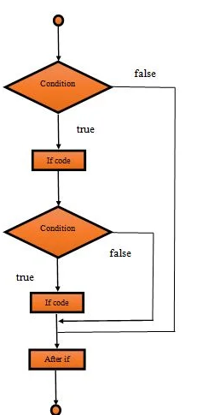
Data-flow-diagram of Nested if Block

Slide 16
int age=25;
int weight=70;
if(age>=18)
{
if(weight>50)
{
System.out.println("You are eligible");
}
}

Slide 17
Java Switch Statement
switch statement executes one statement from multiple conditions.
like if-else-if ladder statement
Syntax
switch(expression)
{
case x: // code block
break;
case y: // code block
break;
default: // code block
}

Slide 18
Switch expression is evaluated once.
Value of the expression is compared with the values of each case.
If there is a match, the associated block of code is executed.
Break and default keywords are optional
Case values must be unique. In case of duplicate value, it renders compile-time error.

Slide 19
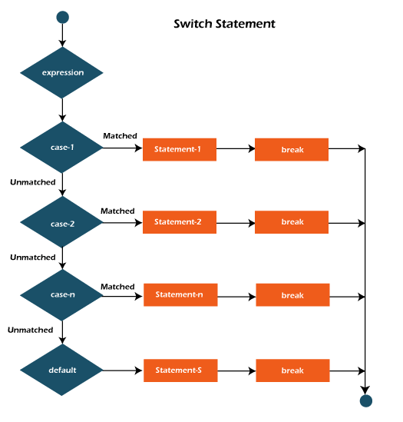

Slide 20
int number=20;
switch(number){
case 10: System.out.println("10");
break;
case 20: System.out.println("20");
break;
case 30: System.out.println("30");
break;
default:System.out.println("Not in 10, 20 or 30");

Slide 21
String name = "Mango";
switch(name){
case "Mango":
System.out.println("It is a fruit");
break;
case "Tomato":
System.out.println("It is a vegitable");
break;
case "Coke":
System.out.println("It is cold drink");

Slide 22
Loops in Java

Slide 23
Loop statements
Loop is designed to execute particular code block till the specified condition is true
do while loop
while loop
for loop
for-each loop

Slide 24
Java While Loop
Loops through a block of code as long as a specified condition is true:
Syntax:
while (condition)
{
//code to be executed
Increment / decrement statement
}

Slide 25
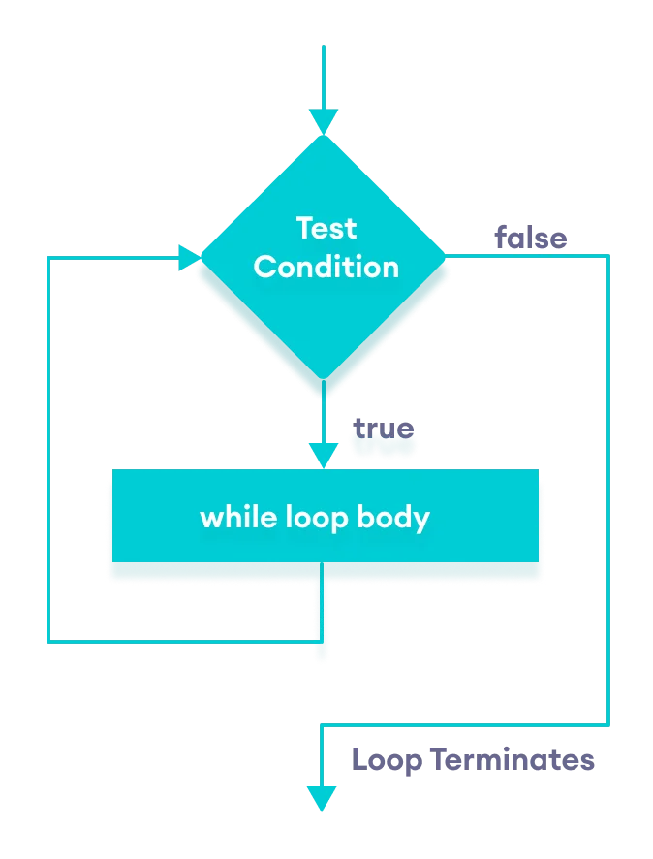

Slide 26
Example
class Main {
public static void main(String[] args)
{
int i = 1, n = 5;
while(i <= n)
{
System.out.println(i);
i++;
}
} }

Slide 27
Note:
Do not forget to increase the variable used in the condition, otherwise the loop will never end!

Slide 28
Java do-while Loop
The do/while loop is a variant of the while loop.
This loop will execute the code block once, before checking if the condition is true, then it will repeat the loop as long as the condition is true.
Syntax:
do{
//code to be executed / loop body
//update statement
}while(condition);

Slide 29
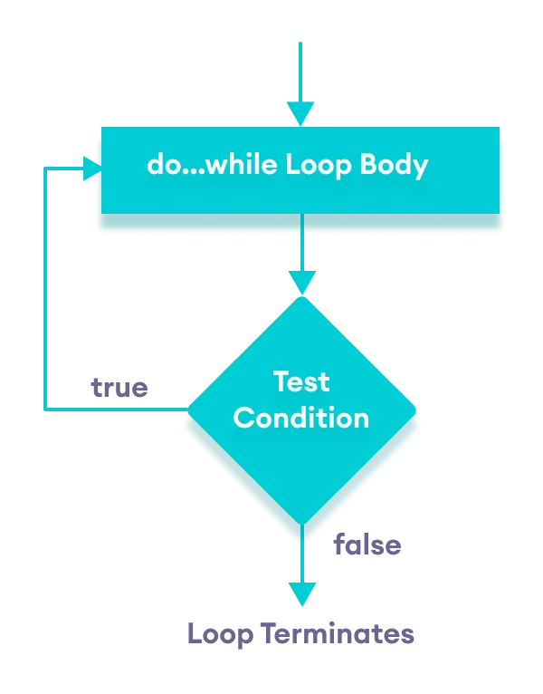
Flowchart of Java do while loop

Slide 30
Example
class Main
{
public static void main(String args[])
{
int i = 0;
do {
System.out.println(i);
i++;
}
while (i < 5);
} }

Slide 31
for Loop
f or loop is used for executing a part of the program repeatedly.
When the number of execution is fixed then it is suggested to use for loop
Syntax:
for(initialization; condition; increment/decrement)
{
//statement or code to be executed
}

Slide 32
Initialization:
It is the initial condition which is executed once when the loop starts.
Here, we can initialize the variable, or we can use an already initialized variable.
Condition:
It is the second condition which is executed each time to test the condition of the loop.
It continues execution until the condition is false.
It must return boolean value either true or false..

Slide 33
3. Increment/Decrement:
It increments or decrements the variable value.
4. Statement:
The statement of the loop is executed each time until the second condition is false.

Slide 34
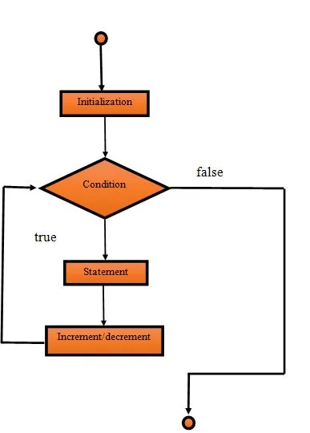

Slide 35
public class ForDemo1
{
public static void main(String[] args)
{
int n, i;
n=2;
for(i=1;i<=10;i++)
{
System.out.println(n+"*"+i+"="+n*i);
}
}
}

Slide 36
Java Nested for Loop
public class NestedForExample {
public static void main(String[] args)
{
for(int i=1;i<=3;i++)
{
for(int j=1;j<=3;j++)
{
System.out.println(i+" "+j);
}
}
}
}

Slide 37
Half pyramid pattern using nested loops
class Main {
public static void main(String[] args) {
int rows = 5;
for (int i = 1; i <= rows; ++i) {
for (int j = 1; j <= i; ++j) {
System.out.print(j + " ");
}
System.out.println("");
}
}
}
Output:
1
1 2
1 2 3
1 2 3 4
1 2 3 4 5

Slide 38
Inverted half pyramid using *
public class Main {
public static void main(String[] args) {
int rows = 5;
for (int i = rows; i >= 1; --i) {
for (int j = 1; j <= i; ++j) {
System.out.print("* ");
}
System.out.println();
}
} }
* * * * *
* * * *
* * *
* *
*

Slide 39
Java break Statement
Break statement is used to break loop or switch statement.
It breaks the current flow of the program at specified condition.
We can use Java break statement in all types of loops such as
for loop
while loop
do-while loop

Slide 40
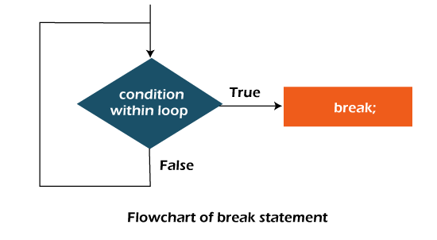

Slide 41
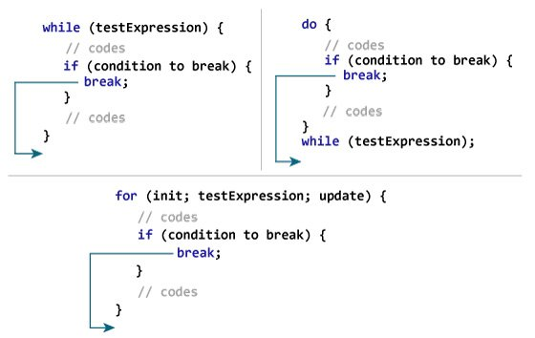

Slide 42
Example
class Test {
public static void main(String[] args) {
for (int i = 1; i <= 10; ++i) {
if (i == 5)
{
break;
}
System.out.println(i);
}
}
}
Output:
1
2
3
4

Slide 43
Break Statement with Inner Loop
//outer loop
for(int i=1;i<=3;i++){
//inner loop
for(int j=1;j<=3;j++){
if(i==2&&j==2)
{
break;
}
System.out.println(i+" "+j);
}
}
Output:
1 1
1 2
1 3
2 1
3 1
3 2
3 3

Slide 44
labeled break Statement
aa:
for(int i=1;i<=3;i++){
bb:
for(int j=1;j<=3;j++){
if(i==2&&j==2)
{
break aa;
}
System.out.println(i+" "+j);
}
}
Output:
1 1
1 2
1 3
2 1

Slide 45
Java continue Statement
Continue statement breaks one iteration (in the loop), if a specified condition occurs, and continues with the next iteration in the loop.

Slide 46
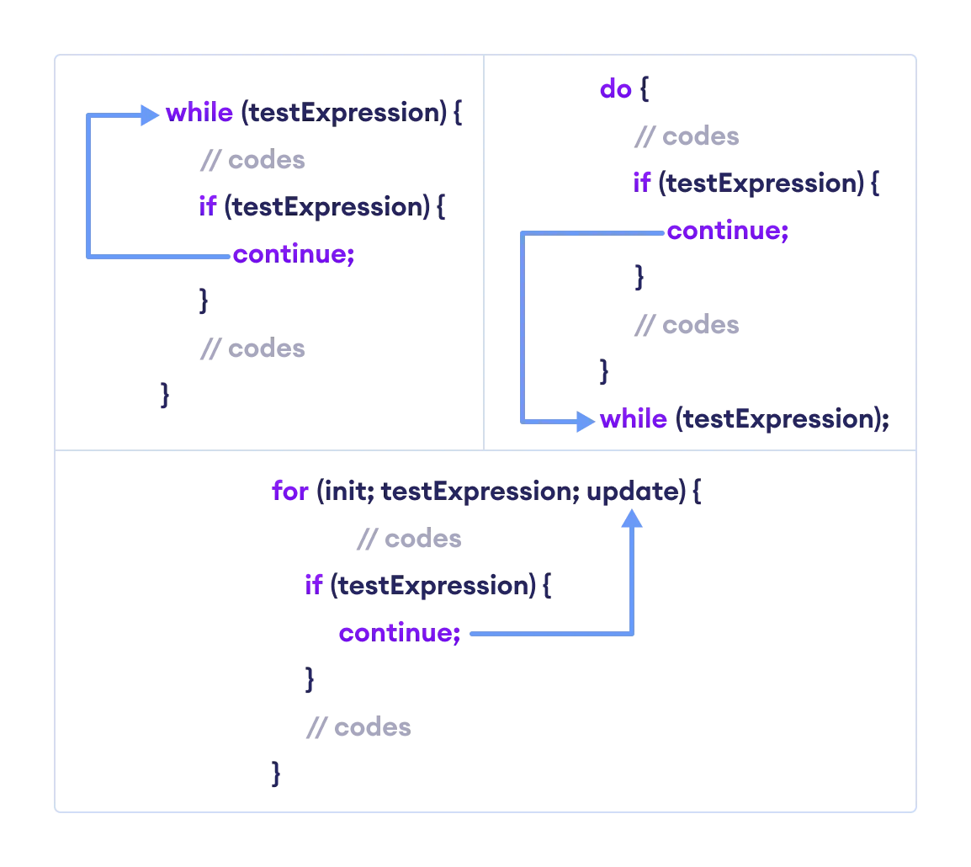
Working of Java continue Statement

Slide 47
Example
class Main {
public static void main(String[] args) {
for (int i = 1; i <= 10; ++i)
{
// if value of i is between 4 and 9 continue is executed
if (i > 4 && i < 9) {
continue;
}
System.out.println(i);
}
} }
Output
1
2
3
4
9
10

Slide 48
Continue Statement with Inner Loop
//outer loop
for(int i=1;i<=3;i++){
//inner loop
for(int j=1;j<=3;j++){
if(i==2&&j==2){
continue;
}
System.out.println(i+" "+j);
}
}
Output
1 1
1 2
1 3
2 1
2 3
3 1
3 2
3 3

Slide 49
Continue Statement with Labelled For Loop
aa:
for(int i=1;i<=3;i++){
bb:
for(int j=1;j<=3;j++){
if(i==2&&j==2){
continue aa;
}
System.out.println(i+" "+j);
}
}
Output
1 1
1 2
1 3
2 1
3 1
3 2
3 3

